Slide 1

Department of Computer Science and Engineering
ITA0302 –Mobile Computing for 5G Technology
Mobile Voting System with OTP Authentication
-By A. Kamalisri (192110429)
Notes:
1
1

Slide 2
Introduction
Increasing demand for secure, accessible, and remote voting systems
OTP (One-Time Password) enhances user identity verification
Ensures only eligible users can cast votes
Useful in elections, surveys, and institutional voting
Reduces human errors and fraud

Slide 3
Problem Statement
Traditional voting systems are time-consuming and lack accessibility
Manual systems prone to errors and tampering
Voter impersonation and multiple voting issues
Low turnout due to physical constraints

Slide 4
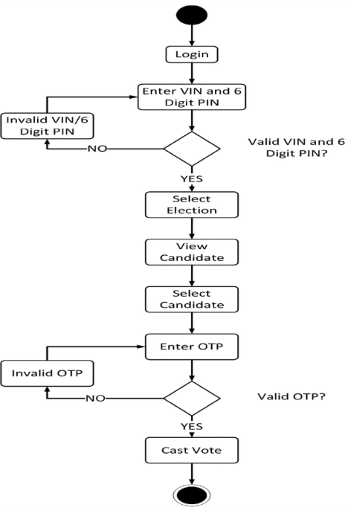
Data flow diagram

Slide 5
Proposed Aim
To design and develop a secure, reliable mobile voting system with OTP-based authentication
Ensure single vote per user and prevent identity fraud
Increase accessibility and convenience of voting

Slide 6
Proposed Objectives
Develop a user-friendly web/mobile interface for voters
Integrate secure OTP-based login mechanism
Create admin panel to manage candidates and voters
Ensure secure vote casting and storage in a database
Generate real-time vote count results

Slide 7
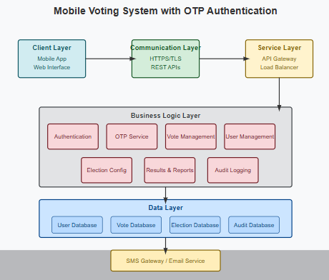
System Architecture
Three-tier architecture:
1. Presentation Layer:
User login and voting interface
2. Logic Layer:
OTP generation and validation
3. Data Layer:
Stores voter info and vote count

Slide 8
Modules
User Module: Register/Login using OTP
Admin Module: Candidate/voter management
Voting Module: Cast votes, view status
Result Module: Tally votes and display results

Slide 9
Tools & Technologies
Frontend: HTML, CSS
Backend: PHP
Database: MySQL
Server: Apache via XAMPP/WAMP
OTP Service: Mail/SMS API (e.g., SMTP/SendGrid)

Slide 10
Database Design
Tables & Key Fields:
Users: user_id, email, otp, status
Candidates: candidate_id, name, party
Votes: vote_id, voter_id, candidate_id, timestamp
Relationships:
One User → One Vote
One Vote → One Candidate
Ensures vote integrity & secure mapping

Slide 11
Code
OTP Generation (PHP)
<?php
function generateOTP($length = 6) {
$characters = '0123456789';
$otp = '';
for ($i = 0; $i < $length; $i++) {
$otp .= $characters[rand(0, strlen($characters) - 1)];
}
return $otp;
}
$otp = generateOTP();
echo "Generated OTP: " . $otp;
?>
Check OTP Expiry (PHP)
<?php
$otpExpiryTime = $row['otp_expiry'];
$currentTime = date("Y-m-d H:i:s");
if ($currentTime > $otpExpiryTime) {
echo "OTP has expired.";
} else {
echo "OTP is still valid.";
}
?>

Slide 12
Features
OTP-based login for added security
One-time voting per user
Real-time result tracking
Admin control panel
Responsive design for mobile devices

Slide 13
Security Considerations
OTP expires after one use or short time
Encrypted database communication
Prevention of SQL injection
User session tracking to avoid duplicate voting

Slide 14
Future Enhancements
Biometric authentication integration
Blockchain-based vote ledger
Push notifications for voting reminders
Multi-language support for inclusivity

Slide 15
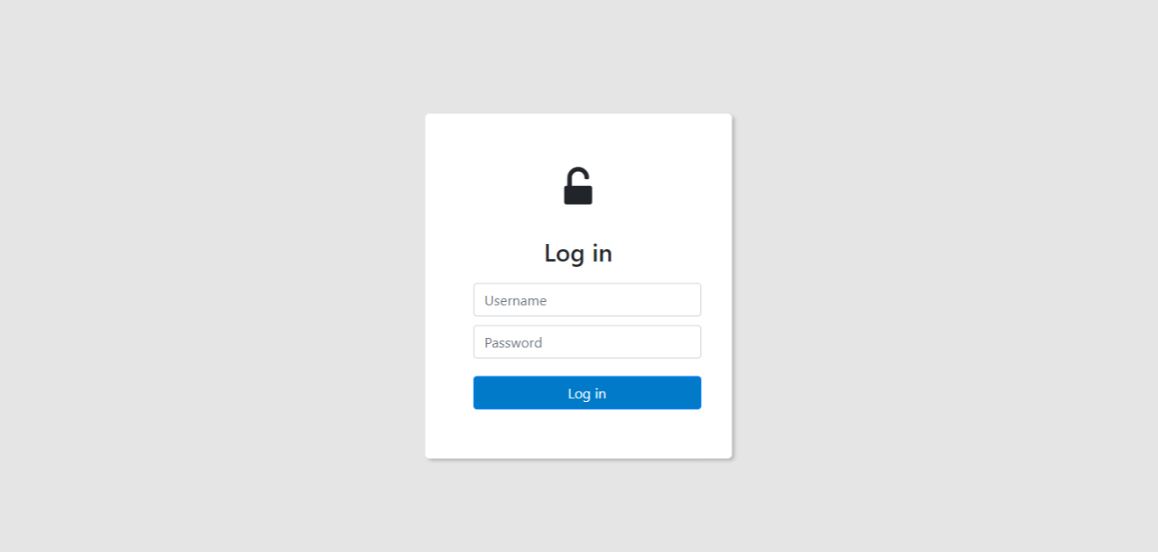
Output

Slide 16
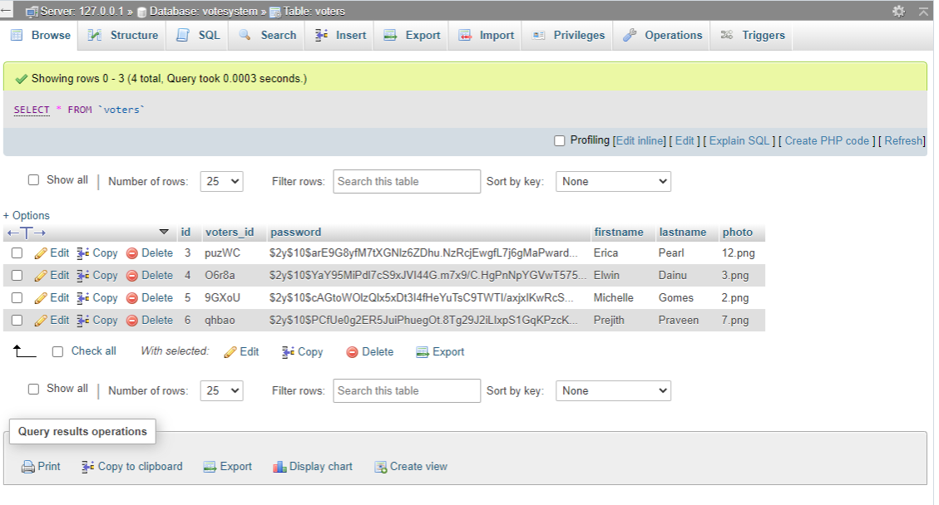
Output

Slide 17
References
R. Sharma et al., "A Survey on E-Voting Systems," International Journal of Computer Applications, 2021.
M. Ali, "OTP Authentication in Web Applications," IEEE Conference on Cyber Security, 2020.
Election Commission of India, "E-Voting Guidelines and Security Framework," Govt. of India, 2022.
D. Kumar et al., "Secure Electronic Voting Using Web Technologies," IJCSIT, 2020.

